Slide 1
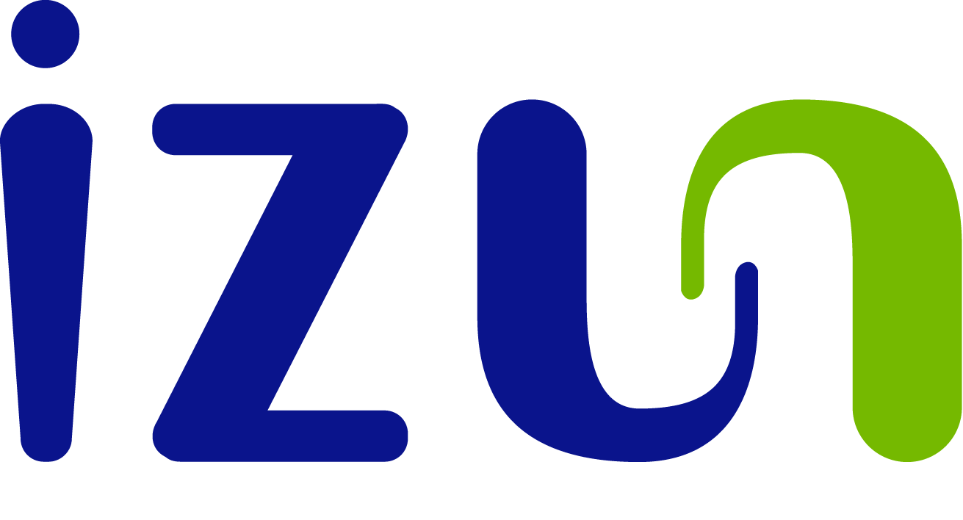
Pharmaceuticals
Unique botanically-based pharmaceutical solutions
CORPORATE PRESENTATION
Q4 2017

Slide 2
Forward Looking Statements
This presentation contains “forward-looking statements” as that term is defined in the Private Securities Litigation Reform Act of 1995. For this purpose, any statements contained herein or which are otherwise made by or on behalf of the Company that are not statements of historical facts may be deemed forward‑looking statements. Without limiting the generality of the foregoing, words such as “may,” “will,” “to,” “plan,” “expect,” “believe,” “anticipate,” “intend,” “could,” “should,” “would,” “estimate,” or “continue,” or the negative or other variations thereof or comparable terminology are intended to identify forward‑looking statements. Shareholders are cautioned that all forward‑looking statements involve risk and uncertainties which may cause results to differ materially from those set forth in the statements. Such risks and uncertainties include, but are not limited to the following: the success of research and development activities and the speed with which regulatory authorizations and product launches may be achieved; government regulation generally; competitive developments; the ability to successfully market products domestically and internationally; difficulties or delays in manufacturing or issues relating to manufacturing capacity; commercial obstacles to the successful introduction of brand products generally; legal defense costs, insurance expenses, settlement costs, and the risk of an adverse decision or settlement relating to product liability, patent protection, governmental investigations, and other legal proceedings; the Company’s ability to acquire and protect patents and other intellectual property both domestically and internationally; the absence of certainty regarding the receipt of required regulatory approval or the timing or terms of such approvals; any changes in business, political and economic conditions; business interruption due to hurricanes or other events outside of the Company’s control.
Readers are cautioned not to place reliance on these forward‑looking statements, which are valid only as of the date they were made. The Company undertakes no obligation to update or revise any forward‑looking statements to reflect new information or the occurrence of unanticipated events or otherwise, except as expressly required by law.

Slide 3
Mission Statement
Izun is dedicated to harnessing the transformative power of botanically-derived active ingredients to develop safe and effective new medicines to address human health needs.

Slide 4
Core Technology
Izun technology is focused on the analysis of botanical sources, understanding the biological effect of these botanicals and translating that knowledge into more effective healthcare products.
Primary therapeutic targets are (i) the reduction of inflammation and (ii) the acceleration of tissue repair.
This technology has already resulted in breakthrough healthcare solutions in oral care and wound care and has generated
3 FDA approved products
3 EMA approved products
>65 patents
Izun also has a rich R&D pipeline targeting additional high value market segments in cancer support and women’s health care.

Slide 5
Izun Pharmaceuticals
The natural products market is extremely large, with enormous potential for continued growth. The global market reached $107B in 2017,
with 16% CAGR*
The market exhibits a need for scientifically proven natural products.
Izun is transforming the natural products industry
by applying
rigorous scientific & pharmaceutical standards to develop safe and highly effective botanically-derived products.
* Source Nutraceuticals World 03.07.2012

Slide 6
Current Therapeutic Segments
Pharma
Oral Care
Cannabis based Health Care
Wound Care
Oncology Support
Women’s Health

Slide 7
Wound Care
Curasite® has been approved by the FDA and is intended for use as a prescription product for the management of:
Chronic wounds (diabetic foot ulcers, pressure ulcers, venous stasis ulcers, arterial ulcers)
Burn therapy (radiation burns, first and second degree burns)
The FDA has approved a unique claim for Curasite as a ‘first line therapy’ for wound care.
In a recently completed phase II double-blinded clinical trial, Curasite demonstrated over 80% repair of chronic diabetic foot ulcers that did not respond to other treatments.

Slide 8
Oncology Support
Izun’s IZN-6N4 was designed to prevent the onset and relieve the symptoms of severe Oral Mucositis (OM), the painful inflammation and ulceration of the oral cavity that is a consequence of chemotherapy and radiation therapy (CRT) utilized in treating cancer.
OM affects:
50% of chemotherapy patients
90% of head & neck cancer patients treated with CRT
Nearly 100% of bone marrow transplant patients
Untreated OM can result in the cessation of life-saving CRT; the prevention of OM is a significant factor in the success of this therapy.
Izun has recently completed a Phase IIb, 110 patient international multi-center double-blind clinical trial.
Results indicate:
Reduction in Severity of Oral Mucositis
Reduced mouth & throat soreness
Reduced pain
Better overall health

Slide 9
Vulvovaginal Atrophy (VVA)
Izun has developed IZN-6N-VS, a botanically-based cream for the treatment of symptomatic VVA that has none of the health risks associated with estrogen hormonal therapy.
VVA is the thinning of the vaginal and vulvar tissue due to low estrogen levels, an extremely common condition in post-menopausal women (over 1.1B worldwide by 2025) and in women undergoing breast cancer therapy.
It is painful and leads to increased urinary tract infection, vaginal dryness, localized bleeding and painful intercourse.
In a recently completed Phase IIA trial, conducted at Seattle Women's Health, IZN-6N-VS demonstrated a highly significant, long-lasting therapeutic benefit.
Results were presented at the 2017 North American Menopause Society.

Slide 10
Izun Oral Care (IOC)
IOC has developed the only topical Oral Care system that both reduces inflammation and promotes gum repair.
This breakthrough approach for the treatment of periodontal disease has the potential to revolutionize the dental market.
Periodontitis affects more than 50% of the adult population in the US and EU*.
This therapeutic area has not seen the introduction of any new preventive products in the last 30 years.
IOC products are approved by both the FDA and the EMA.
*Source: US CDC July 2015

Slide 11
CannRx Technology
Izun Pharmaceuticals’ unique technology platform provides a strong technical foundation to revolutionize the Cannabis market.
CannRx is focusing on three separate aspects of the cannabis market:
development of FDA approved Rx products (for CINV and for Cachexia)
development of unique clinically tested products for the medical marijuana industry (sleep, pain, Parkinson’s, etc.)
development of the Cannabis Reactor, a novel extraction and drug delivery technology to optimize and deliver accurate, controlled dosing of Cannabis-based products with unprecedented improvements in yields.

Slide 12
Business Strategy
Izun intends to:
Focus resources on Oncology support and VVA and, once FDA approvals are achieved, build dedicated direct/indirect sales channels (license products outside North America)
Monetize/license/spin off non-core business segments in non-dilutive transactions
Control the core technology for all segments
Our current plan is to manufacture the bulk active ingredients.

Slide 13
Management Team
Meet the professionals who are delivering success
William Z. Levine, DDS Executive Chairman and Founder
Elliot F. Hahn, Ph.D. Vice Chairman & Executive Director
Leslie Kraus COO/CFO
Gabriel Nussbaum, MD, Ph.D. Director of Scientific
Affairs
Amy Rosenbluh, Ph.D. Director of Production
Laboratory Director

Slide 14
Contact Information
Thank You
You can contact us at
Dr. Bill Levine (Chairman) wzlevine@izunpharma.com
Phone: 1 212-618-6357 or
+972 (0)72 245 6172
Fax: +972 (0)2 586 1814
botanically based pharmaceutical products

